Slide 1
Introduction
To
PECS
Picture Exchange Communication System

Slide 2
Let’s get to know each other!

Slide 3
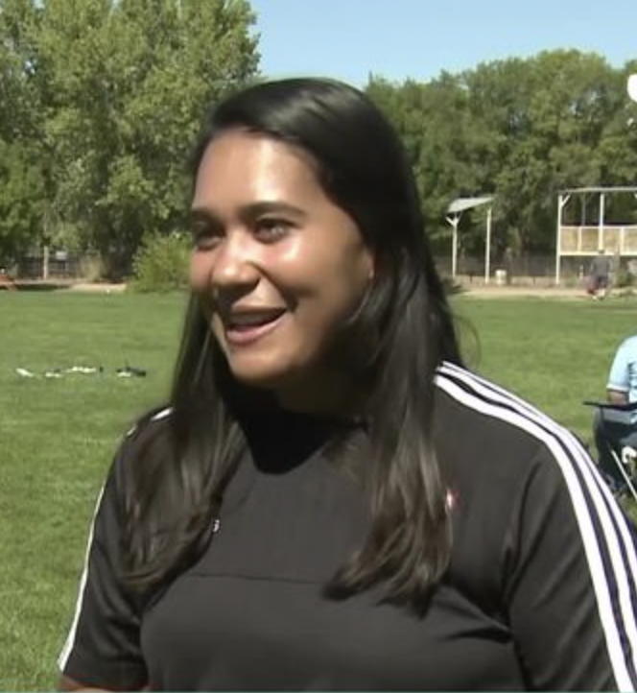
Danessa Posen
Special Education Teacher
Regional TOPSoccer Coach of the Year 2020
Multiple family members living with disabilities

Slide 4
Introduce yourself
OR
Mention a memory
If you are sitting at a table with someone new…introduce yourself with 3 facts, get creative ! (e.g. I am bilingual, I have traveled to Central America, and I was trained classically in chorus for 7 years.)
This one time on the pitch…

Slide 5
What is PECS?

Slide 6
A unique alternative/augmentative communication system
It combines knowledge from the fields of applied behaviour analysis and speech-language pathology to produce an effective method for teaching functional communication
The primary goal of PECS is to teach functional communication.

Slide 7
PECS consists of six phases
teaching an individual to give a single picture of a desired item or action to a “communicative partner” who immediately honors the exchange as a request
teach discrimination of pictures and how to put them together in sentences
more advanced phases, individuals are taught to use modifiers, answer questions and comment.

Slide 8
Phase 1, 2 & 3
Phase 1
How to Communicate - Individuals learn to exchange single pictures for items or activities they really want.
Phase 2
Distance and Persistence - Still using single pictures, individuals learn to generalize this new skill by using it in different places, with different people and across distances. They are also taught to be more persistent communicators.
Phase 3
Picture Discrimination - Individuals learn to select from two or more pictures to ask for their favorite things. These are placed in a PECS Communication Book—a ringed binder with self-adhesive hook fastener strips where pictures are stored and easily removed for communication.

Slide 9
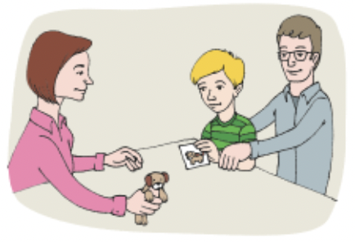
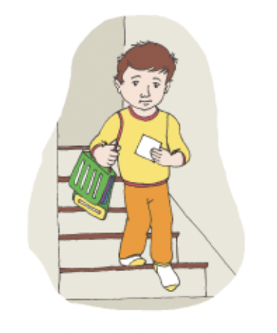
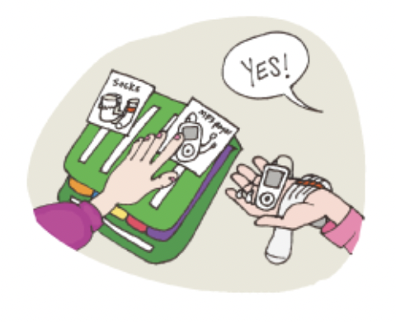

Slide 10
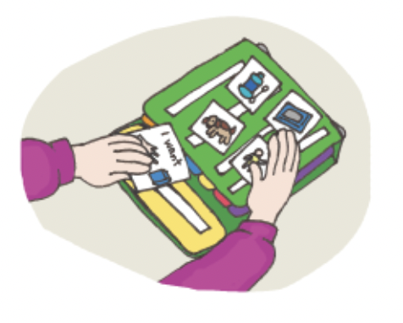
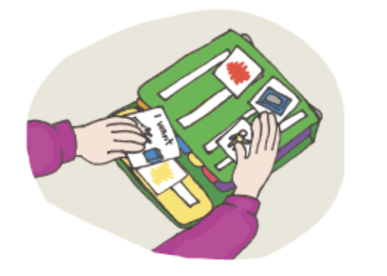
Phase 4
Phase 4
Sentence Structure - Individuals learn to construct simple sentences on a detachable Sentence Strip using an “I want” picture followed by a picture of the item being requested.
Attributes & Language Expansion
Individuals learn to expand their sentences by adding adjectives, verbs and prepositions.

Slide 11
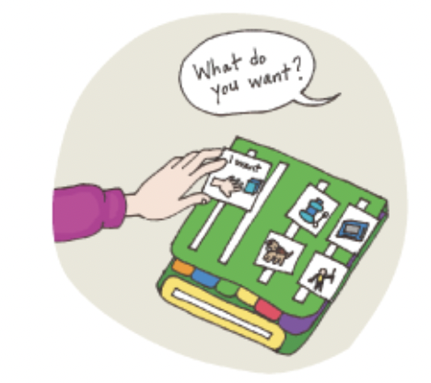
Phase 5 & 6
Phase 5
Responsive Requesting - Individuals learn to use PECS to answer questions such as “What do you want?”
Phase 6
Commenting - Individuals are taught to comment in response to questions such as, “What do you see?”, “What do you hear?” and “What is it?” They learn to make up sentences starting with “I see”, “I hear”, “I feel”, “It is a”, etc.

Slide 12
Knowing the phase of communication your player is in will help you understand their functional communication level.
Recognize current athlete skill set in communication
Plan sessions accordingly
Collaborate with family, and other professionals

Slide 13
But what about other PECS systems?
PECS does use pictures, but it is a specific protocol for teaching expressive use of pictures for an individual to communicate wants and needs, and to comment about the world.
Certain picture symbols may be used and incorporated in the following supports but PECS is not these entirely:
Visual schedules
Choice boards
Task analysis
* Note: We will review these later on !*

Slide 14
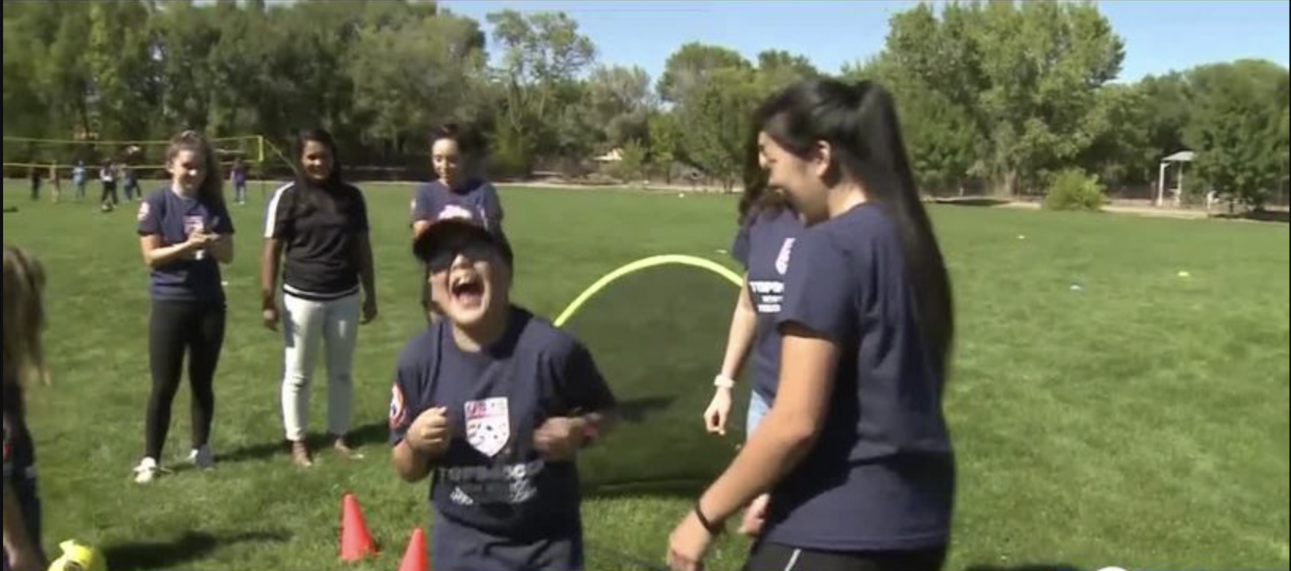
Who is PECS for?

Slide 15
What has been discovered over the 20 plus years since its inception, though, is that PECS can serve as an effective communication system for a range of individuals.
PECS has been used around the world with people aged from 14 months to 85 years
PECS can provide a very effective functional communication system to individuals with no verbal communication, but it can also teach important skills to those who talk
the PECS protocol emphasizes teaching a person to approach others to initiate a communicative interaction

Slide 16
Examples

Slide 17
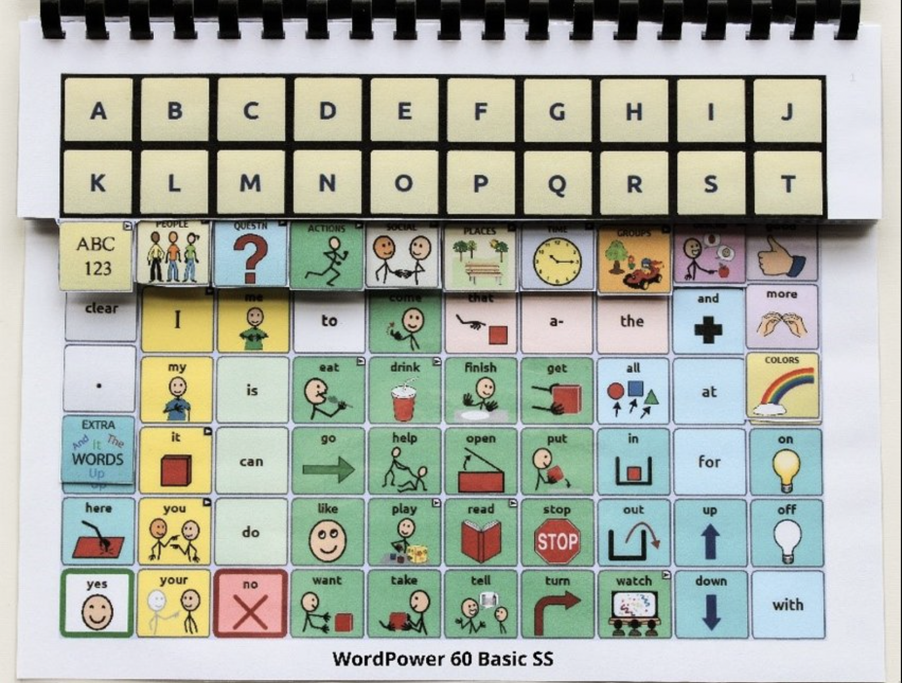
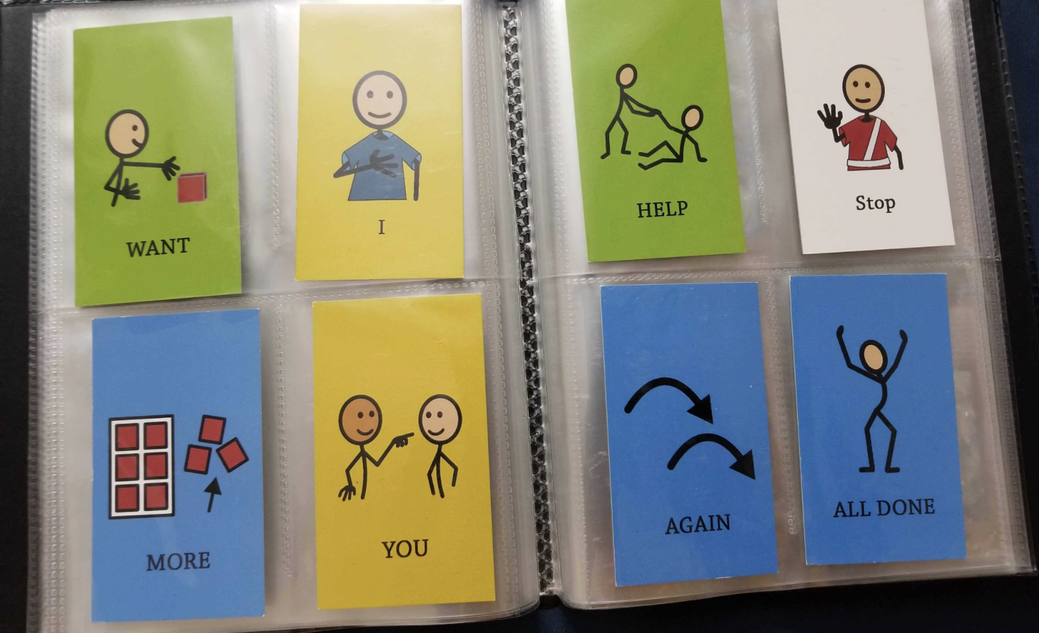
Low Tech boards
A no/low-tech device requires something external to the person using it that is either non-electronic or a very simple electronic device.
Examples of no/low-tech communication strategies
PECS (Picture Exchange Communication System)
communication boards
communication books/notebooks

Slide 18
Low Tech boards
Benefits of no/low tech devices:
Can help facilitate early implementation of AAC
Low cost
Portability
Disadvantages of a no/low tech device:
Vocabulary is limited to the display in front of the user
Communicating complex ideas is difficult
Heavy reliance on communication partners due to a lack of voice or print output.
Due to the lack of symbols or vocabulary, a low-tech system could lead to an underestimation of the AAC user’s abilities.

Slide 19
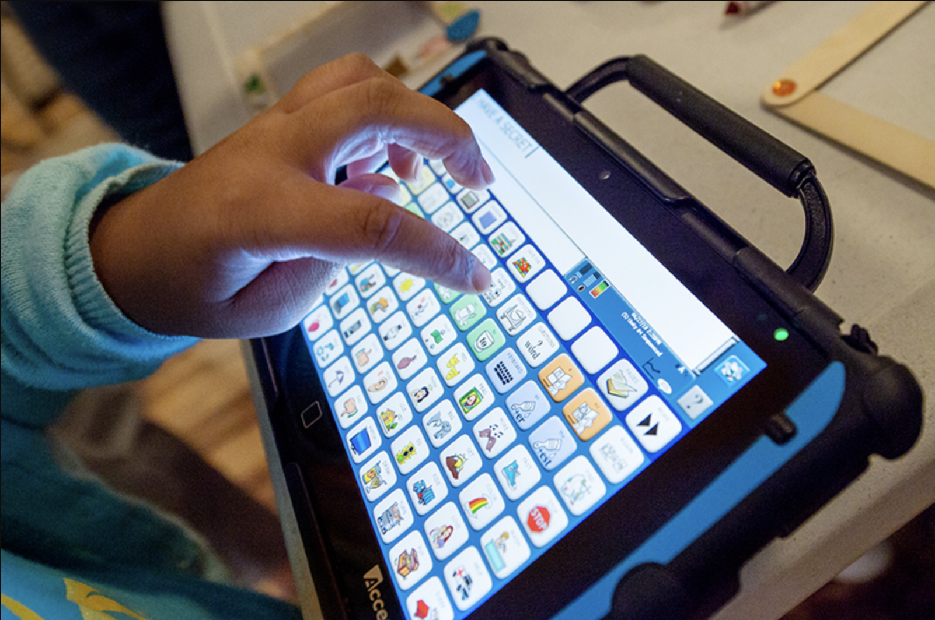
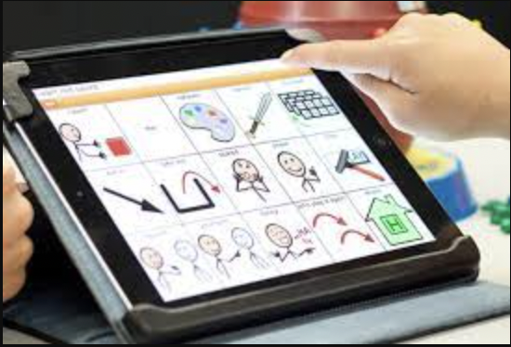
High Tech boards
A high-tech device is a complex electronic device that permits the storage and retrieval of messages, many of which allow the use of speech output.
Examples of high-tech communication strategies
Ipads (with appropriate apps such as Proloquo2go),
other tablets/electronic devices
eye gaze devices (such as Tobii Dynavox)

Slide 20
High Tech boards
Advantages of high-tech devices:
Limitless options of vocabulary
Most have word prediction features at the phrase/sentence level
Auditory and visual feedback provided to user
Allows communication to occur at a distance
Allows the user to send messages without first obtaining the partners’ attention through another mode
Additional options available (email, internet, phone, environmental controls)
Disadvantages of a high-tech device:
Most of these devices can cost thousands because they come with specialized software.
Technology breaks down and gets outdated (which is why it’s always necessary to have a backup low-tech device!)
Lack of portability (in some cases)

Slide 21
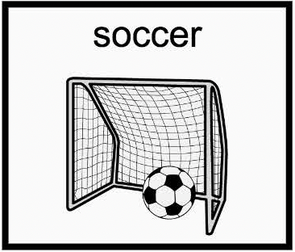
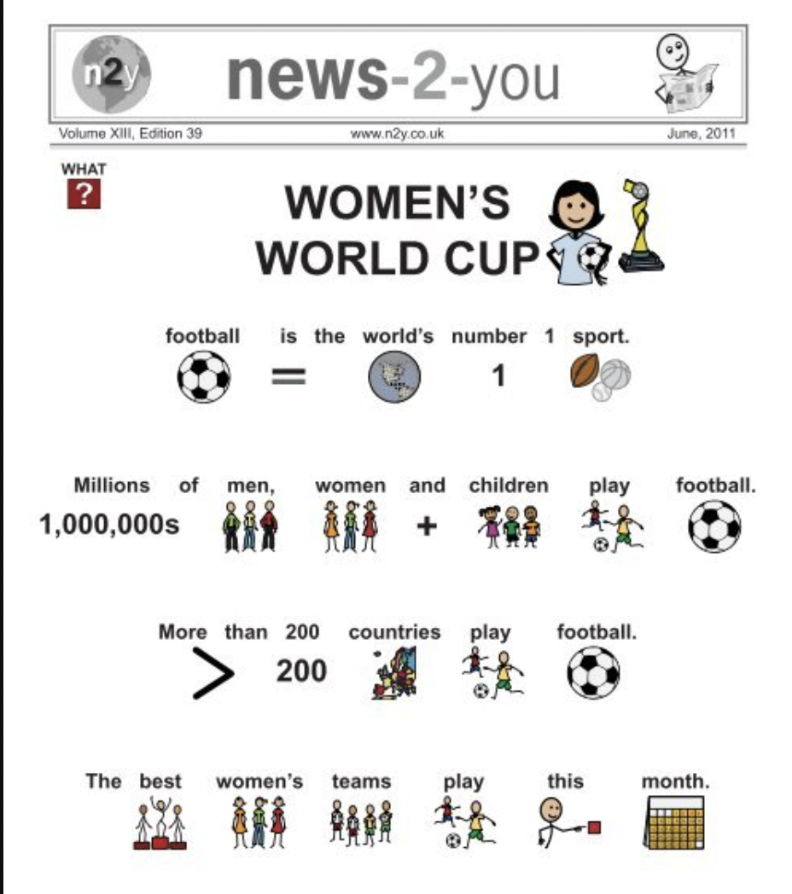
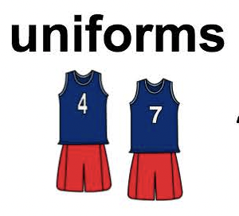
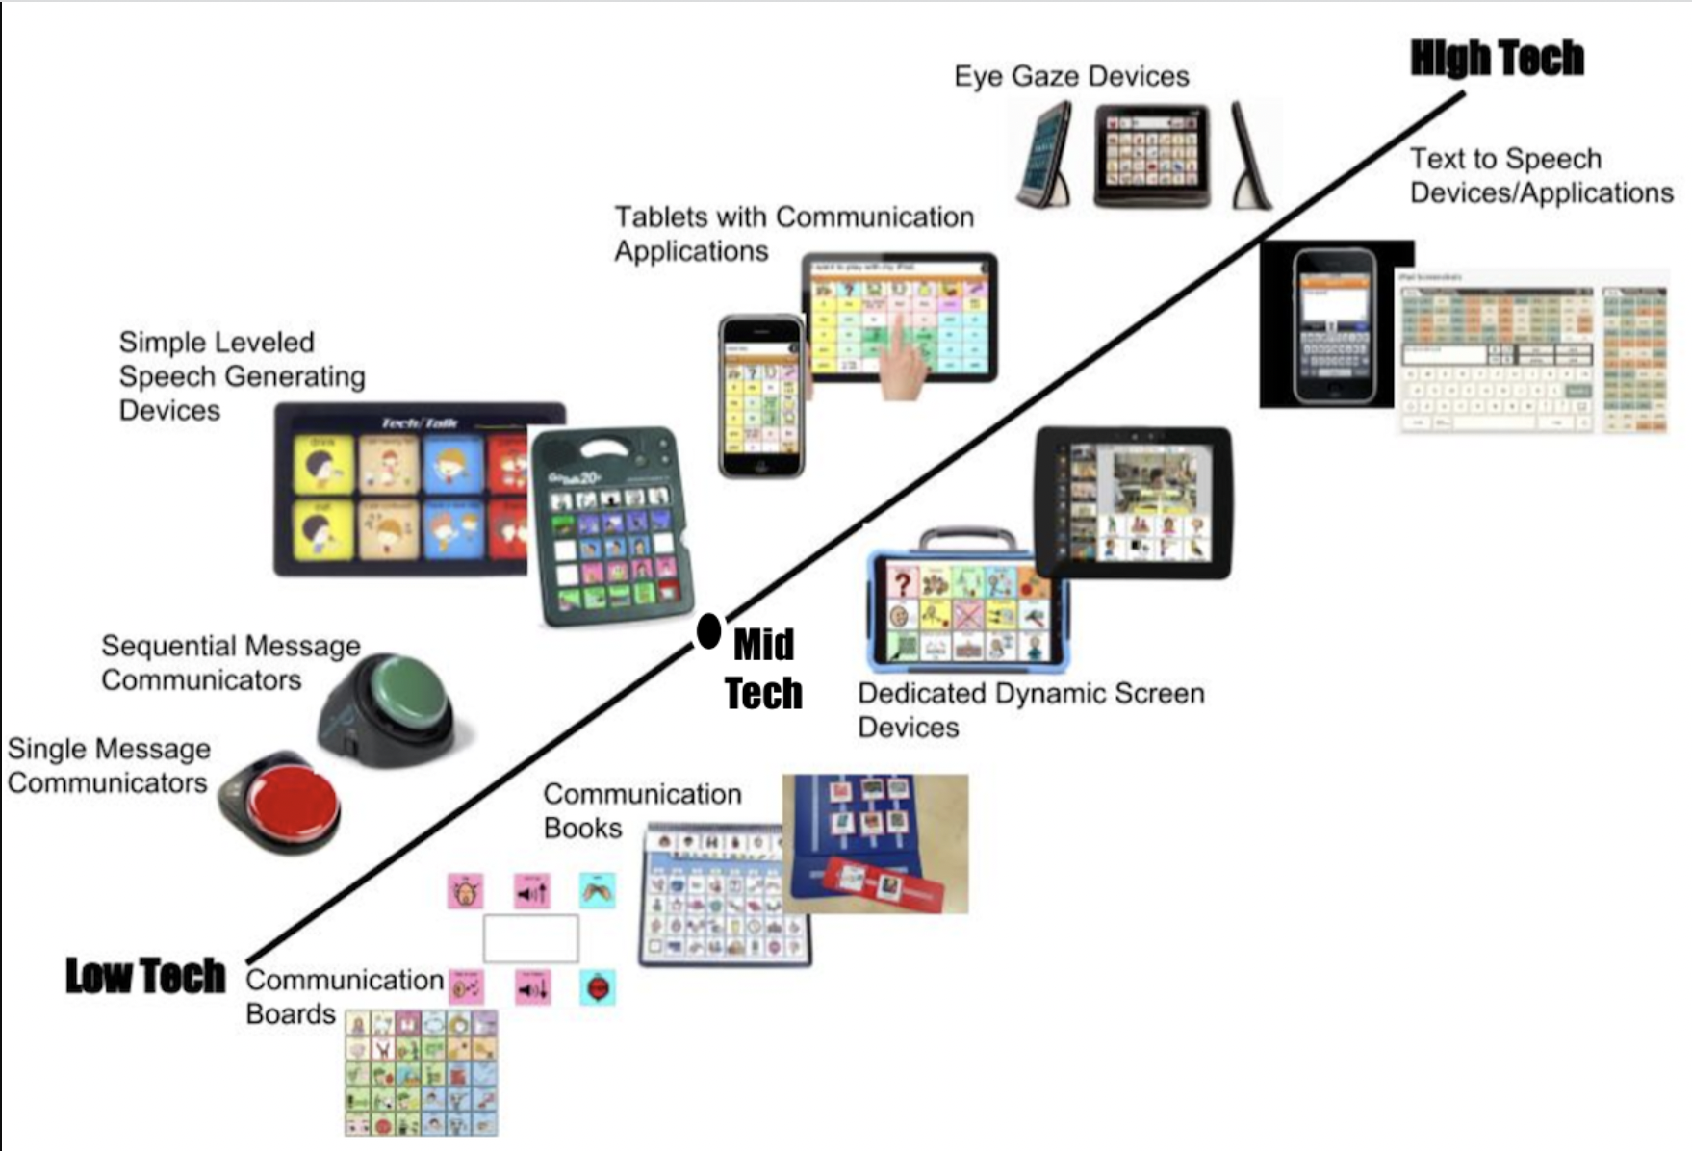
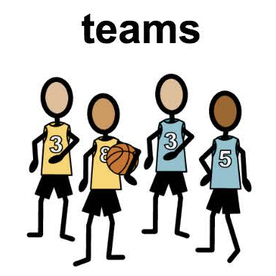
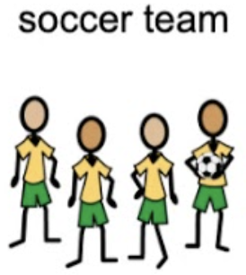
Soccer Examples
Various symbols for soccer depending on PECS programs

Slide 22
How might this look in TOPSoccer ?

Slide 23
New Athlete
Send out/have families fill out form for registration
Form should have a communication section for family commenting
Identify preferred communication for athlete (e.g. ASL, AAC w/PECS, verbal communication et.)
Research preferred communication/ask families for more information on communication

Slide 24
Prior to 1st Session
Prepare for a variety of communication needs
Have families introduce topic of soccer to athlete
Plan session to fit the communication needs of athletes

Slide 25
TOPSoccer Session
Incorporate communication systems in the session
Have a backup communication strategy just in case
Find out what works best for the athlete, buddy, and coach during the session
Note: It may take some sessions to work this out and that’s ok !

Slide 26
Integration & Support
Prepare for new skills being taught for following sessions
Let families/professionals know what new vocabulary or actions the student will be working on.
Reach out to professionals/personnel that work with athlete on their communication
Email teachers/SLPs
Don’t be afraid to ask for support or ask questions !

Slide 27
Have you seen a PECS in your program?
TALK IT OUT
What has PECS looked like in your TOPSoccer program ?
What did you do to support the athlete?
Who did you reach out to for questions?
How did you incorporate alternative communication in your sessions?
Note: If you have not had any exposure yet…think potentially what it might look like in your program, brainstorm

Slide 28
Time to move!

Slide 29
If not PECS…then _____ ?

Slide 30
Reminder !
PECS teaches functional communication.
An expressive use of communication specific to the athlete
Explicitly taught in phases

Slide 31
What other visual supports can I incorporate ?
Visual Schedule
Task Analysis
Choice Board

Slide 32
Visual Schedules

Slide 33
What is a visual schedule?
a graphic representation of scheduled tasks and activities
They are very useful for breaking down tasks that have multiple steps and ensuring that children follow rules and deadlines.
Visual schedules reduce anxiety by providing consistency and reducing resistance that comes with certain activities
The visual schedule itself is a constant reminder to students where they should be, what they should be doing and when she should start and finish.

Slide 34
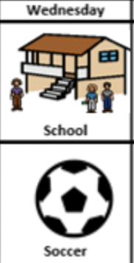
How and When can I use it?
Make sure athlete has an understanding of sequence
E.g. first, second, third - first, then - etc.
Make schedule manageable
Does athlete need every activity listed? Do they need one activity at a time listed?
Personalize schedule
Create schedule and visual supports to match tasks
Cue and prompt as necessary to look at schedule
Mark it as completed
Check mark box
Moving PECS symbol off board
Reinforce
E.g. snack, favorite activity for last 5-10 minutes of session, using new materials etc.

Slide 35
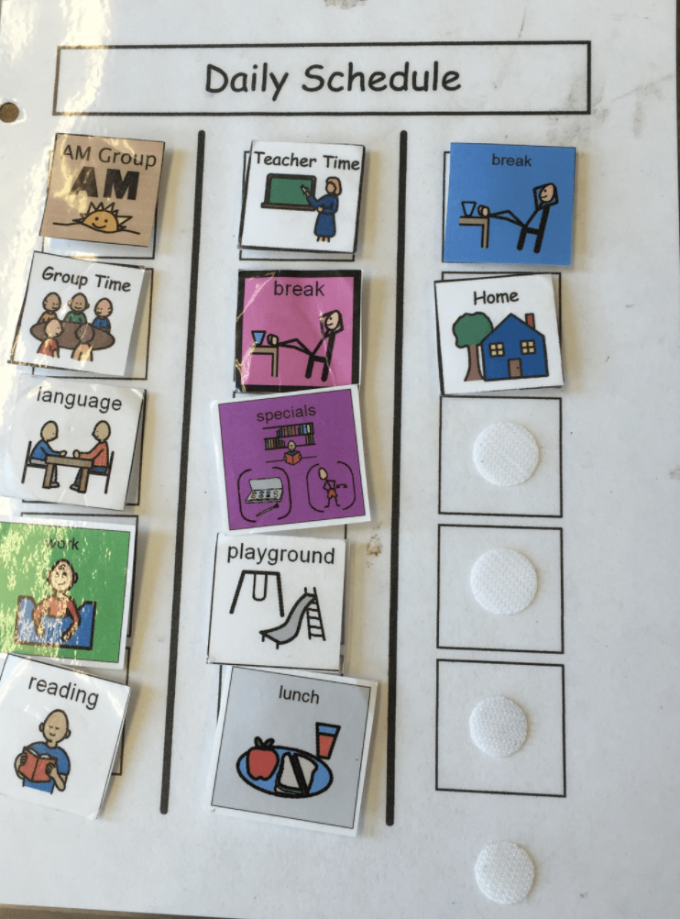
How and When can I use it?
Use when athletes have anxiety about what comes next
Use when athletes need support during activity transitions
Use when session has many activities

Slide 36
Why use it?
Reduce anxiety
Some athletes get nervous when they do not what comes next
Some athletes may not want to participate if they do not know what is happening.
Provide security for time management
Athletes may review to schedule to either identify that the session is almost completed
Pushes athletes to continue participation in the session from knowing what comes next

Slide 37
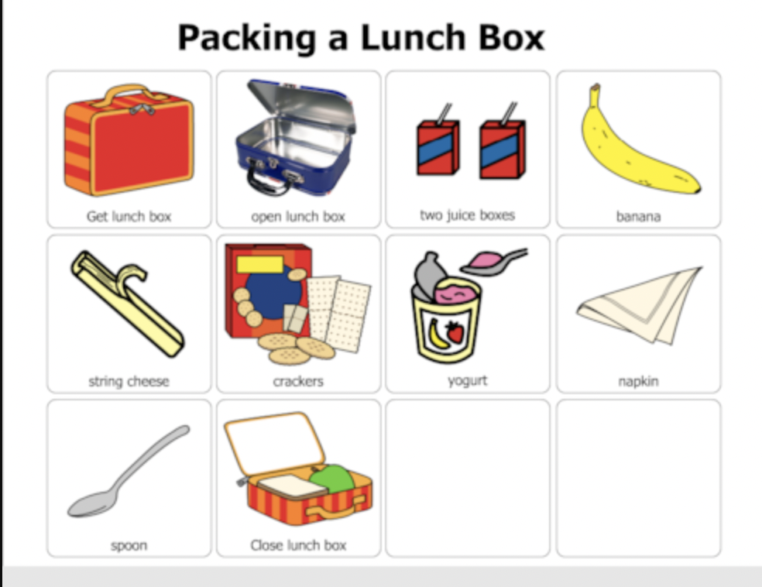
Task Analysis

Slide 38
What is task analysis?
the process of breaking a skill down into smaller, more manageable components
Once a task analysis is complete, it can be used to teach athletes a skill that is too challenging to teach all at once
The target skill should consist of a series of chained discrete steps
Skills that require a task analysis typically consist of multiple components that comprise a larger skill
E.g. multi step drills, complex foot skills, passing movements, introduction to build out line/regulations etc.

Slide 39
How and When can I use it?
Identify what prerequisite skills the athlete needs in order to complete the task
E.g. Which part of the foot to use for passing to try a new passing sequence
Make sure your athlete has prerequisite skills to complete the new task
Break the target skill into manageable chunks
Croife 1. Ball is in front of players feet. 2. Player moves dominant foot over the soccer ball 3. The foot is placed in front of the soccer ball with the heel 6 inches of distance from the soccer ball. etc
Test out task analysis
Teach new skill

Slide 40
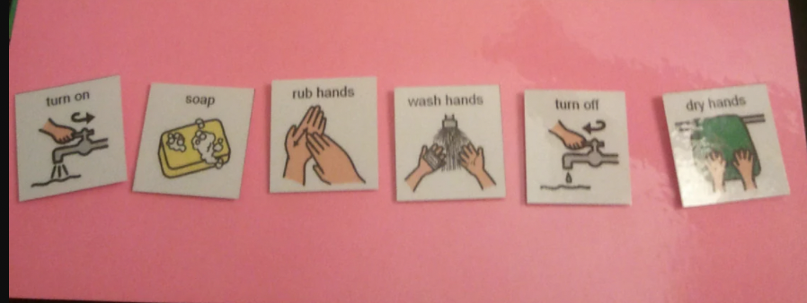
Why use it?
Introducing a complex skill/move
Individual skill building
Send home task analysis as practice for a skill
Build independence and understanding of a specific complex task

Slide 41
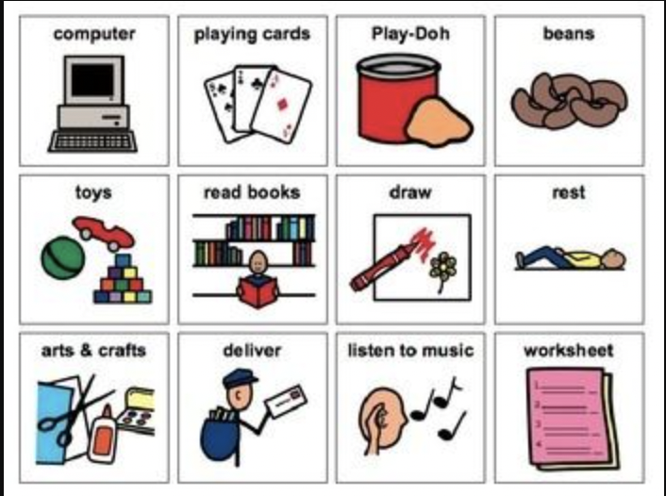
Choice Boards

Slide 42
What is a choice board?
A visual support that includes objects, photos, pictures, line drawings or text which can be used by your child to communicate what activity, item or task they would like.
Typically a minimum of 2 choices would be presented to your child at one time for them to make a choice.
In order for a choice board to be an effective strategy, the athlete must be able to make a choice between a preferred and non-preferred item/activity

Slide 43
How and When can I use it?
1. Coach/buddy creates a board with writing or pictures of the choices being offered that are relevant to the task (e.g. favorite soccer activity, snack break, free time to pass, extra water break etc.)
It is important to make sure that each of the chosen activities are available and to always honour the choice your child makes.
2. Review the choices with the athlete.
3. Allow the athlete to select from the available choices.
4. Once the athlete selects their choice, coach/buddy immediately provides the choice, and rewards/reinforces the athlete uses

Slide 44
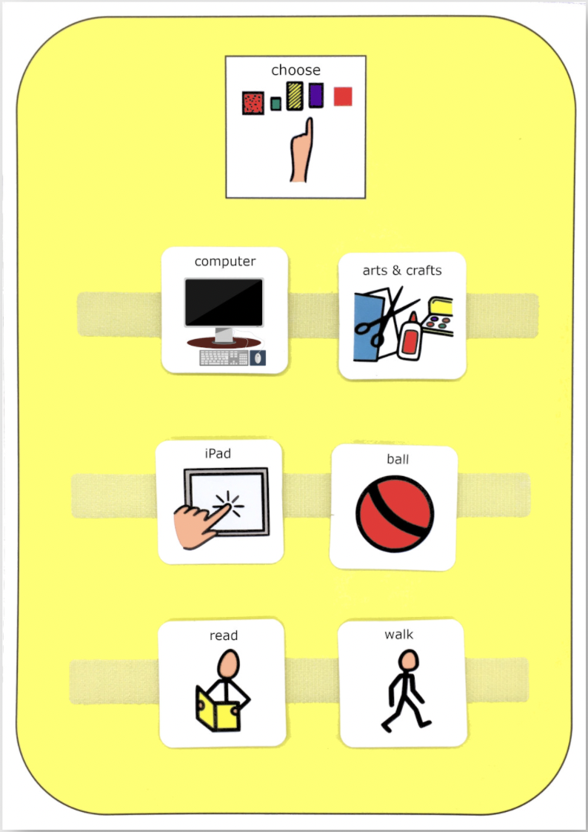
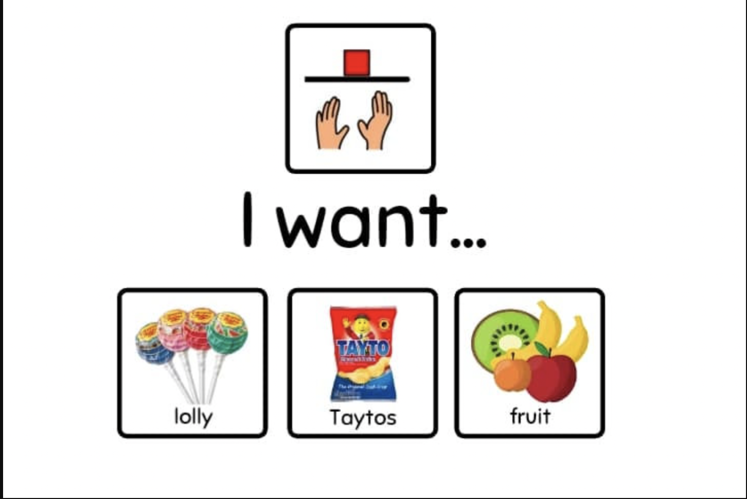
How and When can I use it?
To offer a choice in the order of tasks to be completed
To offer a choice to pick what to work on/for
To offer a choice in the materials being used for an activity

Slide 45
Why use it?
May increase athlete motivation by providing them with a choice over which activity comes next or what they would like to work for.
Providing this choice may give the athlete a sense of control over their environment and therefore increase their level of participation.
Used to offer the athlete a choice before an activity/task begins in order to increase participation and decrease the possibility of the athlete engaging in challenging behaviours.

Slide 46
Summary

Slide 47
PECS
a unique alternative/augmentative communication system
the PECS protocol emphasizes teaching a person to approach others to initiate a communicative interaction
Explicitly taught in phases
An expressive use of communication specific to the athlete

Slide 48
Other Visual Supports
Visual Schedule
a graphic representation of scheduled tasks and activities
Use when athletes need support during activity transitions
Use when session has many activities
Task Analysis
the process of breaking a skill down into smaller, more manageable components
Introducing a complex skill/move
Build independence and understanding of a specific complex task

Slide 49
Other Visual Supports
Choice Board
A visual support that includes objects, photos, pictures, line drawings or text which can be used by your child to communicate what activity, item or task they would like.
May increase athlete motivation by providing them with a choice over which activity comes next or what they would like to work for.
Providing this choice may give the athlete a sense of control over their environment and therefore increase their level of participation.

Slide 50
Questions

Slide 51
Resources
https://www.erinoakkids.ca/getmedia/3c701adc-46a1-4f4e-9813-5ff6121fff65/000103-AODA-Choice-Boards.pdf
https://app.snapandread.com/workspace#action=open_url&source=https%3A%2F%2Fautismpdc.fpg.unc.edu%2Fsites%2Fautismpdc.fpg.unc.edu%2Ffiles%2FTaskAnalyis_Steps_0.pdf
https://www.appliedbehavioranalysisprograms.com/faq/what-is-visual-scheduling/
https://www.lispeech.com/differences-no-low-tech-high-tech-aac-devices/#:~:text=A%20no%2Flow%2Dtech%20device,the%20use%20of%20speech%20output.
https://pecsusa.com/pecs/
https://app.snapandread.com/workspace#action=open_url&source=https%3A%2F%2Fpecsusa.com%2Fdownload%2FMythsandMisconceptions2010.pdf

